Slide 1
HTTP Triggers to manage Snowflake table data
Mid-Project Presentation – Data And Analytics Unit
By Gavin Aren
Mentor: Marella Anji Reddy

Slide 2
What are Azure and Snowflake?
Azure
A range of cloud services, including compute, analytics, storage and networking.
I am using Azure Functions, allows me to deploy blocks of code to their server and it is an always-on service so my service will be always be available. I don’t have to worry about any server maintenance, running costs, updates etc.
Snowflake
Cloud based data-warehousing company. Allows you to mobilise data with near unlimited scale, concurrency and great performance.
Separates storage from compute so customers can pay for storage and compute separately, and its cheap

Slide 3
Explanation of my project
I am creating HTTP endpoints that trigger a function when given the right parameters.
Meaning, given the right input, the endpoint will trigger some Python code in the back-end, process this input.
I have been making 4 triggers, GET, POST, DELETE and PUT (UPDATE), each of which come with a unique URL to access them. These trigger the appropriate action (such as fetching, adding or delete data) to a Snowflake table they are connected to.
These are all written in Python, and then uploaded/deployed to Azure’s Function’s service

Slide 4
My Task Management System

Slide 5
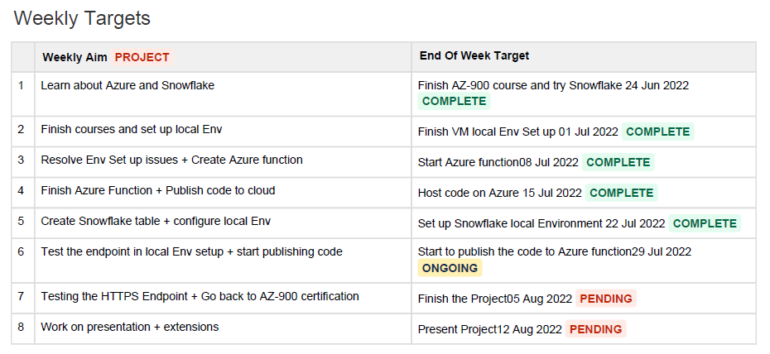
Old weekly plan

Slide 6
Live demo of first 4 HTTP triggers

Slide 7
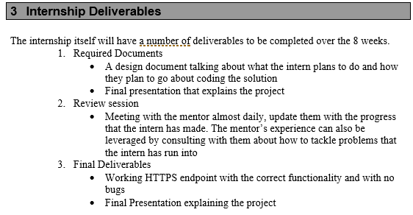
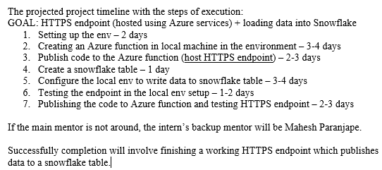

Reflection on Workflow doc

Slide 8
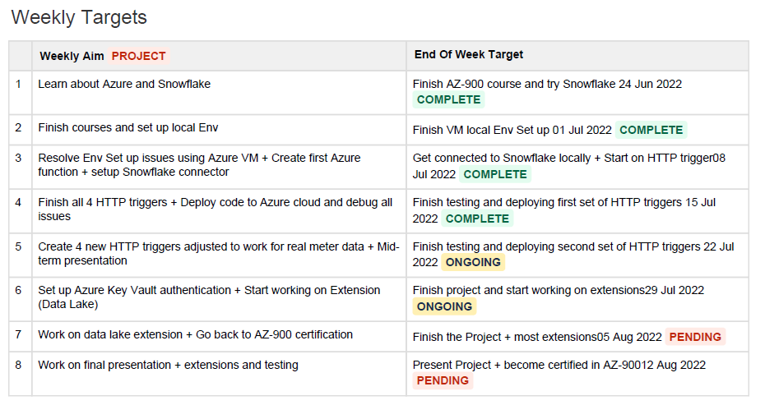
New Weekly Plan (Week 5 onwards)

Slide 9
Real meter data demo with new triggers

Slide 10
Things I have learnt
Professionals must operate with responsibility and set their own deadlines
Took a week and half of setting up local env issues until I eventually switched to an Azure Virtual Machine as this project. It is a part of the job to know how to resolve your own technical issues and raise tickets etc.
Enjoyed solving problems on my own, gained confidence, sometimes got a new perspective from Anji on various issues
Exec Lounge talks have been absolutely excellent

Slide 11
The Bigger Picture
I’m adding value in creating this deliverable as it couldn’t have been automated. A lot of parts of this project are hard-coded very specifically to the type and format of meter data that is being stored in the Snowflake table. The problem solving I did was very specific to this application.
This project can be integrated within larger applications later on within other projects. These URL’s, once-deployed, can be used like an API in the back–end of any application that has a good GUI to interface with users.

Slide 12
What is left to do
Finish up last adjusted UPDATE trigger for the new meter data
Add some Azure KeyVault authentication
Do some extension to do with a data lake
Prepare for the AZ-900 certification

